Slide 1

EWZ Challenge 3 Virtual Energy Storage Team “Energy Online” Jiggar Shah (DMAVT), Michael Jordi (DMTEC), Michael Stemmle (DINFK), Simon Oeschger (DMTEC), Stefan Zemljic (DINFK)

Slide 2
Problem - Today, 40% nuclear energy → goal: 0% by 2034 - Slow growth of renewables (incentives, storage) Solution - Create an incentive system to grow renewables (DAO) - Store “the right to obtain energy” as a token

Slide 3

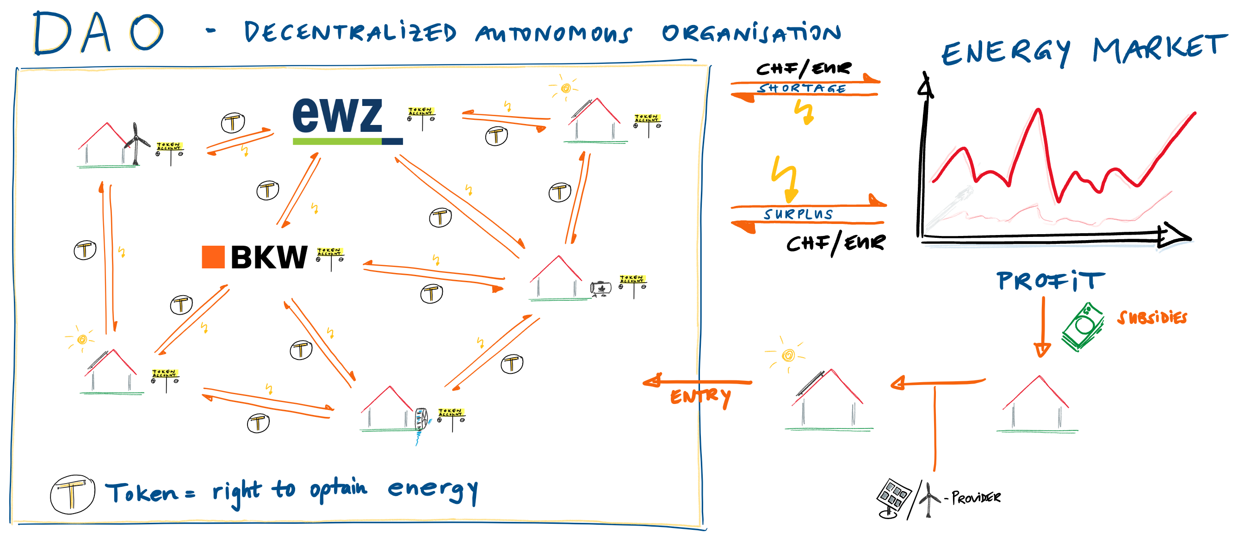

Slide 4
Disruption Potential
- Power suppliers lose monopolistic positions
- P2P trading without (cantonal) borders
- DAO acts as a very efficient self growing system
- DAO acts as a virtual power plant for power suppliers
- EWZ = Participant in DAO + grid, pv, meter provider
Difficulties / Open Challenges
- Secure smart meters and information transfer
- Legal uncertainty (Certificates, Token-qualification, …)

Slide 5
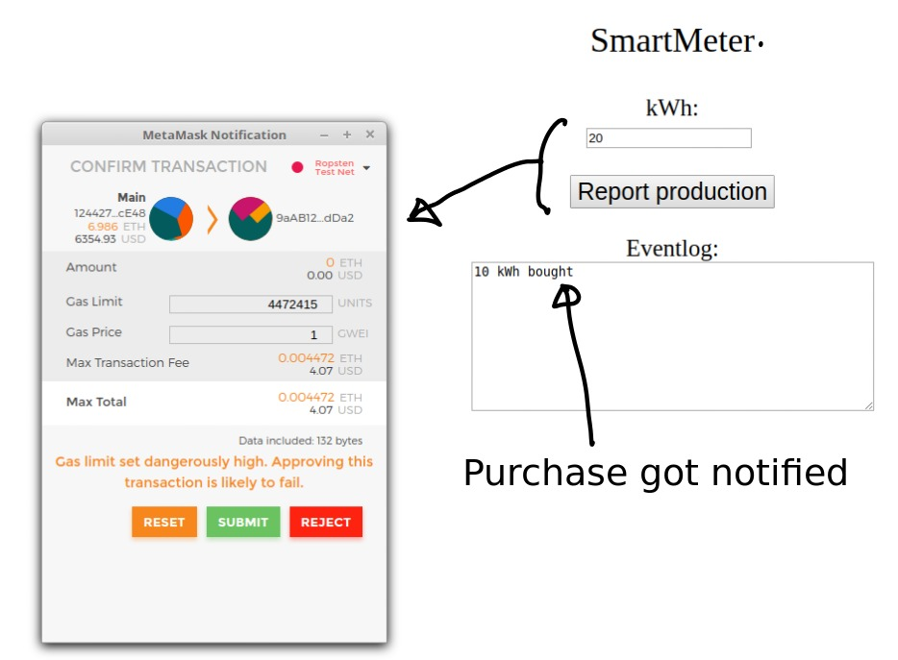
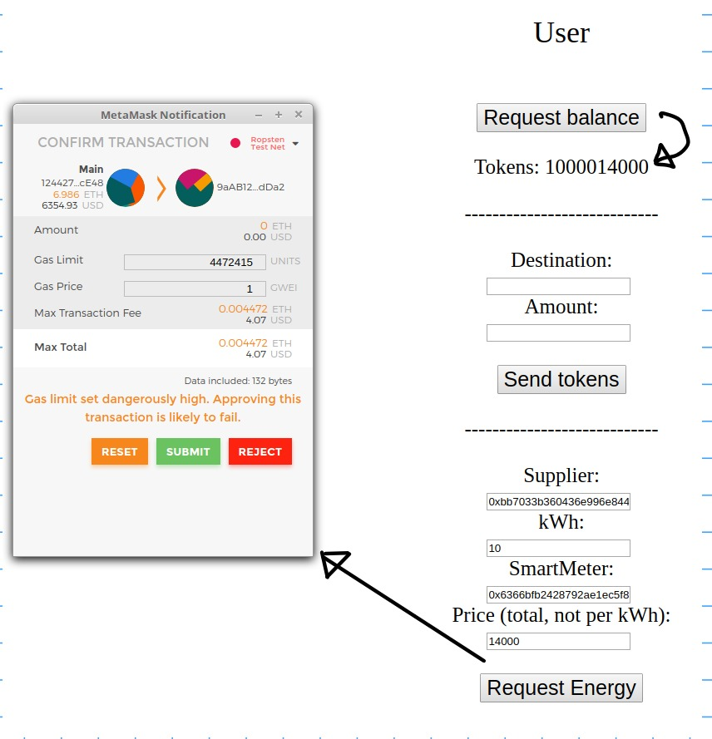
Software Demo

